Slide 1

Content Based Image Retrieval of MRI Scans of Brain on Hexagonal Sampled Grid Under the Guidance of Prof. P.D. Desai
By:
Rohit Raj
Suraj R. Prabhu
Gagan Purad

Slide 2
Abstract
Image processing is an expanding field with its applications spreading across several domains.
There is extensive use of digital images for medical purposes which involves critical decisions to be made based on the elucidation of medical images such as MRI scan, CT scan, X-ray etc., and calls for substantial research.
This paper is based on the project aimed at processing of MRI scans of brain.
The proposed system performs content based retrieval of cases similar to the MRI scan loaded as query using Gabor wavelet based edge detection on hexagonal resampled grid.

Slide 3
Load query Image
Proposed Methodology
Database Images
Hexagonal Resampling
Hexagonal Resampling
Edge Detection Using Gabor Filters
Edge Detection Using Gabor Filters
Shape Feature Extraction using Moment Invariants
Shape Feature Extraction using Moment Invariants
Shape Feature Extraction using GLCM
Shape Feature Extraction using GLCM
Euclidean Distance Calculation
Query Feature
Vector
Database Feature Vector
Retrieval of Similar Cases

Slide 4
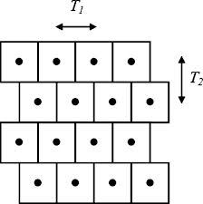
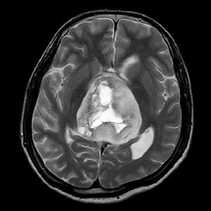
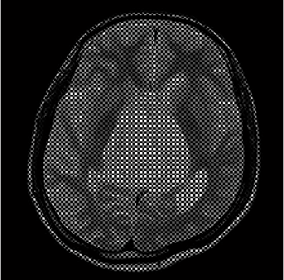
Hexagonal Sampled grid
Half Pixel Shift Method
Query image
Resampled Image

Slide 5
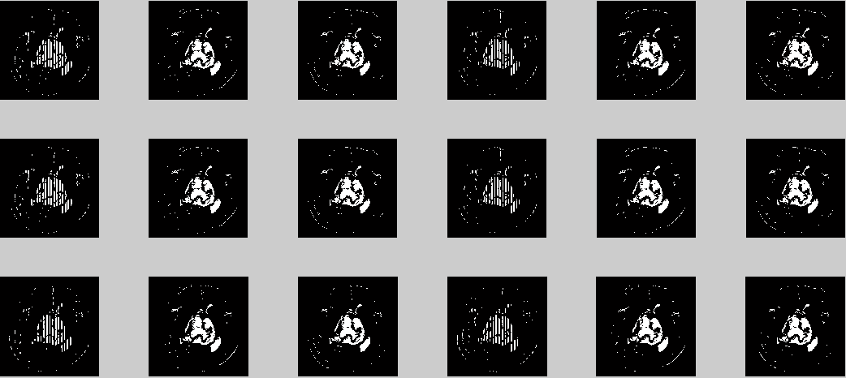
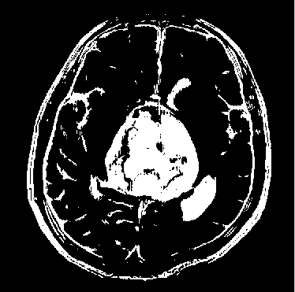
Shape Feature Extraction
Shape can be described by simple geometric features such as moment of inertia, skew invariants, center of gravity etc.
The extraction of shape features starts with detection of edges. For this purpose Gabor filter is applied on six scale values and three orientations – 0⁰, 60⁰, 120⁰, resulting in 6x3 = 18 edge-maps. Out of these only those satisfying the threshold value are superimposed to get the final edge-map.
Final Edge-map
Gabor Responses

Slide 6
Texture Feature Extraction
Important data regarding the structural arrangement of the surface is contained inside the texture features.
Relationship between the surface and external environment can also be provided by them. For extraction of texture features, Grey Level Co-occurrence Matrix is used.
The texture values are appended to the previously stored shape feature values in the same vector.
Feature vector table
The texture values are appended to the previously stored shape feature values in the same vector.

Slide 7
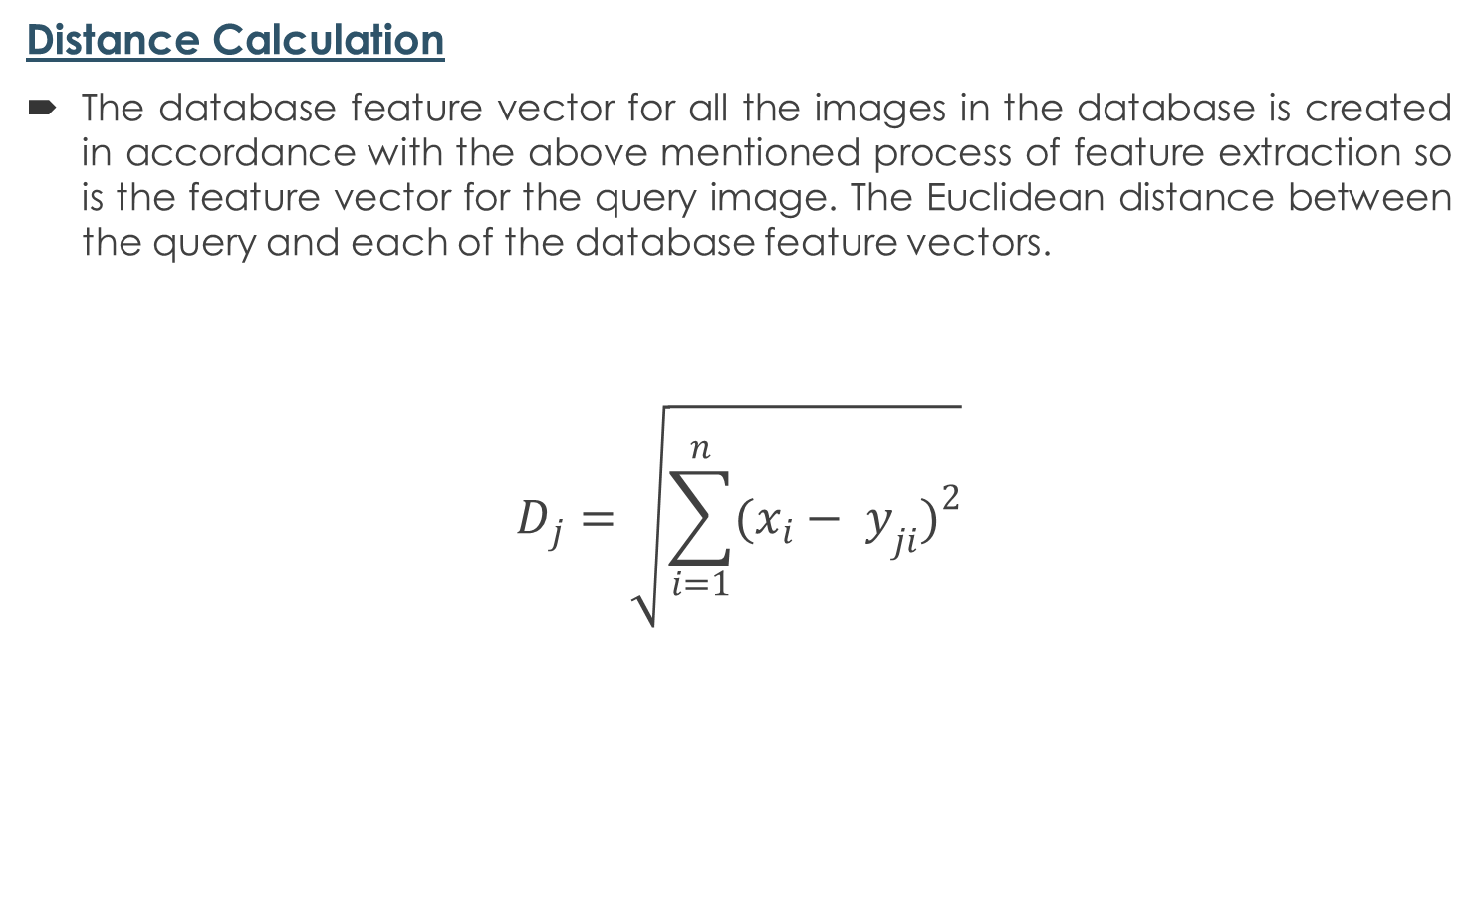
Distance Calculation
The database feature vector for all the images in the database is created in accordance with the above mentioned process of feature extraction so is the feature vector for the query image. The Euclidean distance between the query and each of the database feature vectors.
$$D_{j}=\sqrt{\sum_{i=1}^{n}{{(x_{i}− y_{ji})}^{2}}}$$

Slide 8
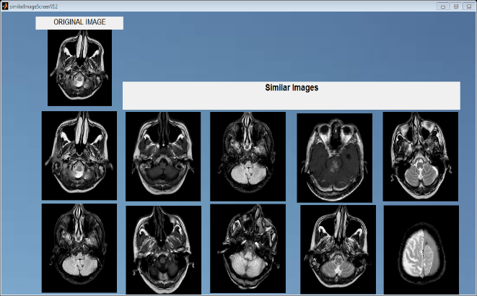
Retrieval Result
Retrieval result for sample 1

Slide 9
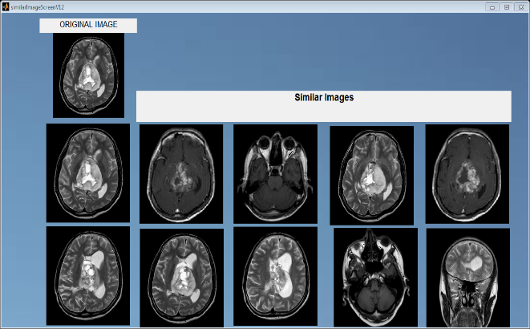
Contd..
Retrieval result for sample 2

Slide 10
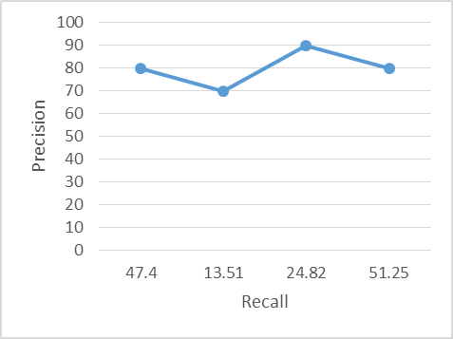
Performance Analysis
Image Id | Precision | Recall
14 | 80.0 | 47.4
24 | 70.0 | 13.5
37 | 90.0 | 24.8
92 | 80.0 | 51.3

Slide 11
Conclusion
This study proposed a model for Content Based Image Retrieval by using shape and texture features of the images.
Shape features are extracted from the hexagonal resampled image using Gabor Filters.
Using GLCM the texture features, are computed.
Final feature vector table contains both shape and texture features, resulting in improved retrieval.
The measure of similarity between the query image and the database images is done by calculating the Euclidean distance.

